Slide 1
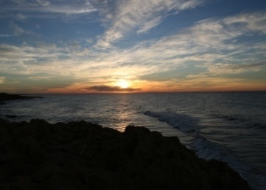
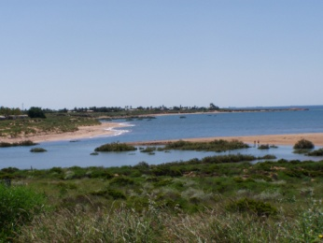
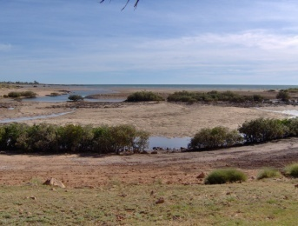
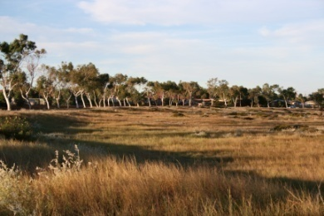
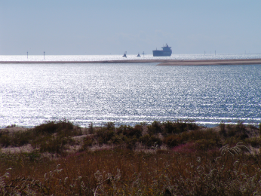
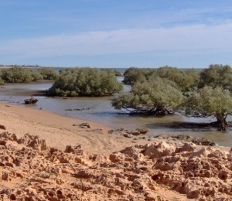
P o r t H e d l a n d
WATERFRONT DEVELOPMENT OPPORTUNITIES
Spoil Bank and Pretty Pool
Council Workshop
November 11, 2009

Slide 2
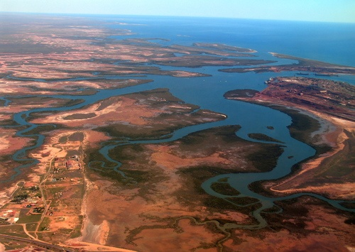
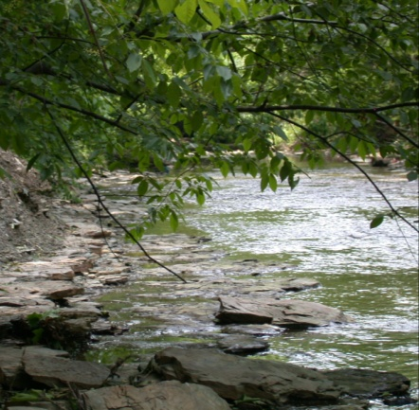
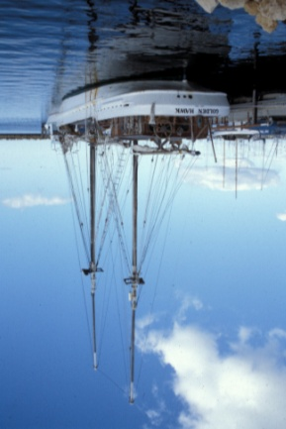
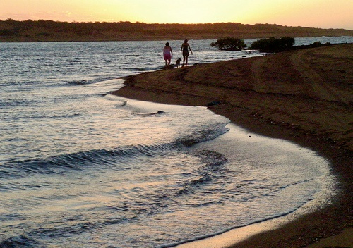
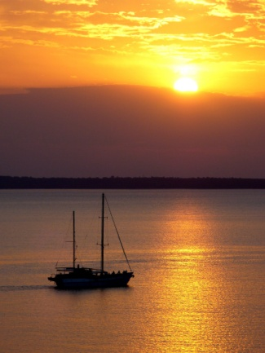
Water ...
… an important part of Port Hedland’s Indigenous history,
and a central role in its modern economy.
Waterfront development creates
environmental benefits
special community places
entertainment and sporting opportunities
tourist attractions
a wonderful place to live …

Slide 3
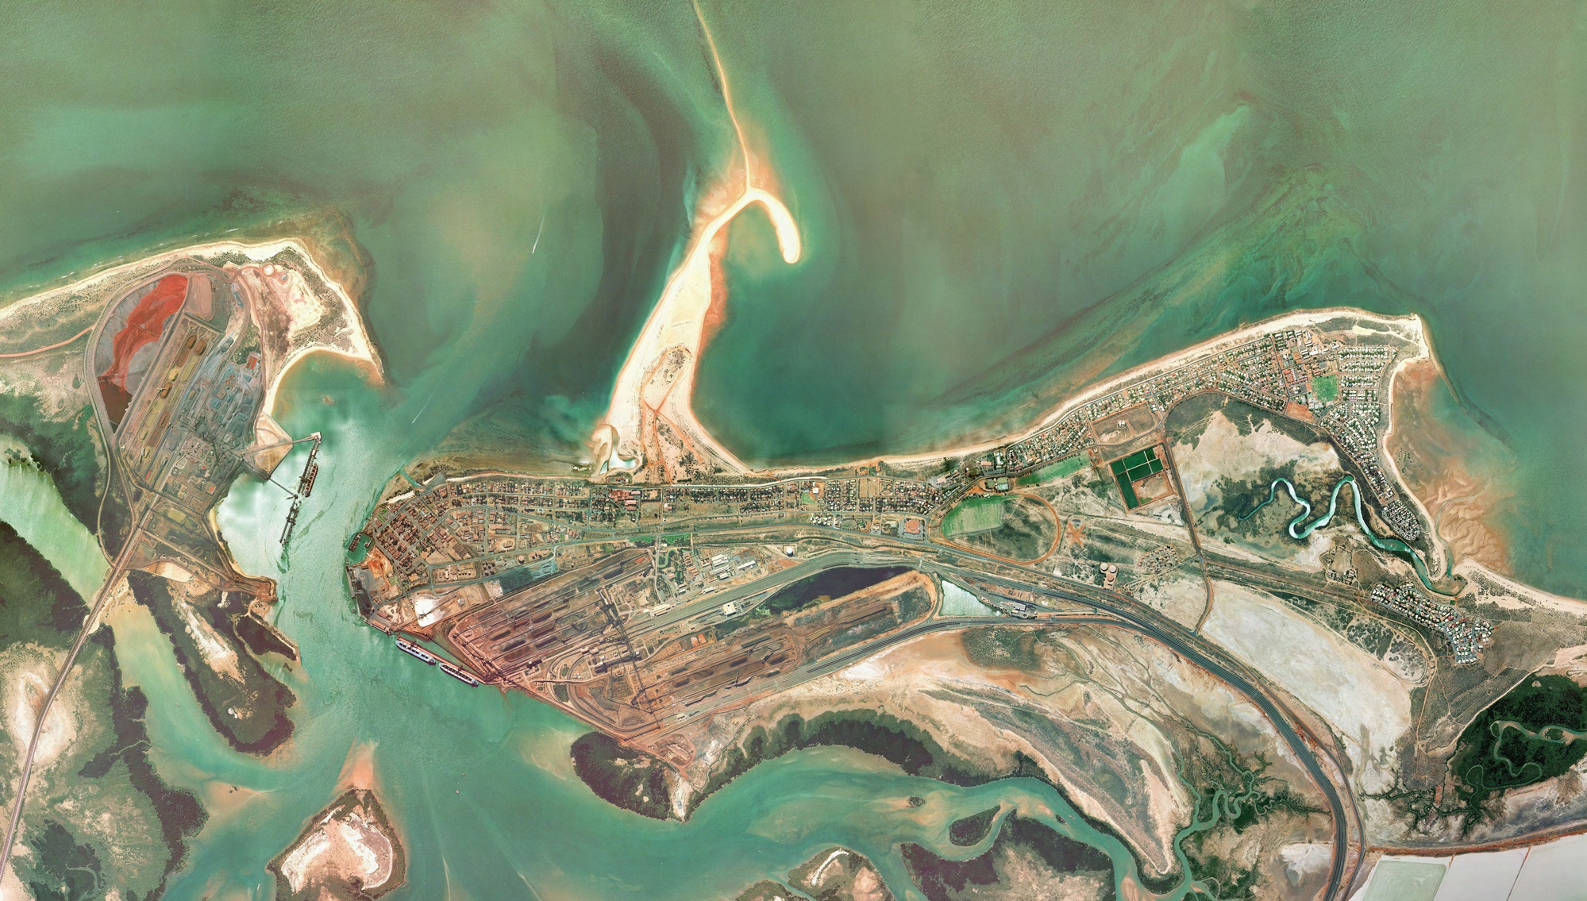
Two key opportunities:
Spoil
Bank
Pretty
Pool

Slide 4
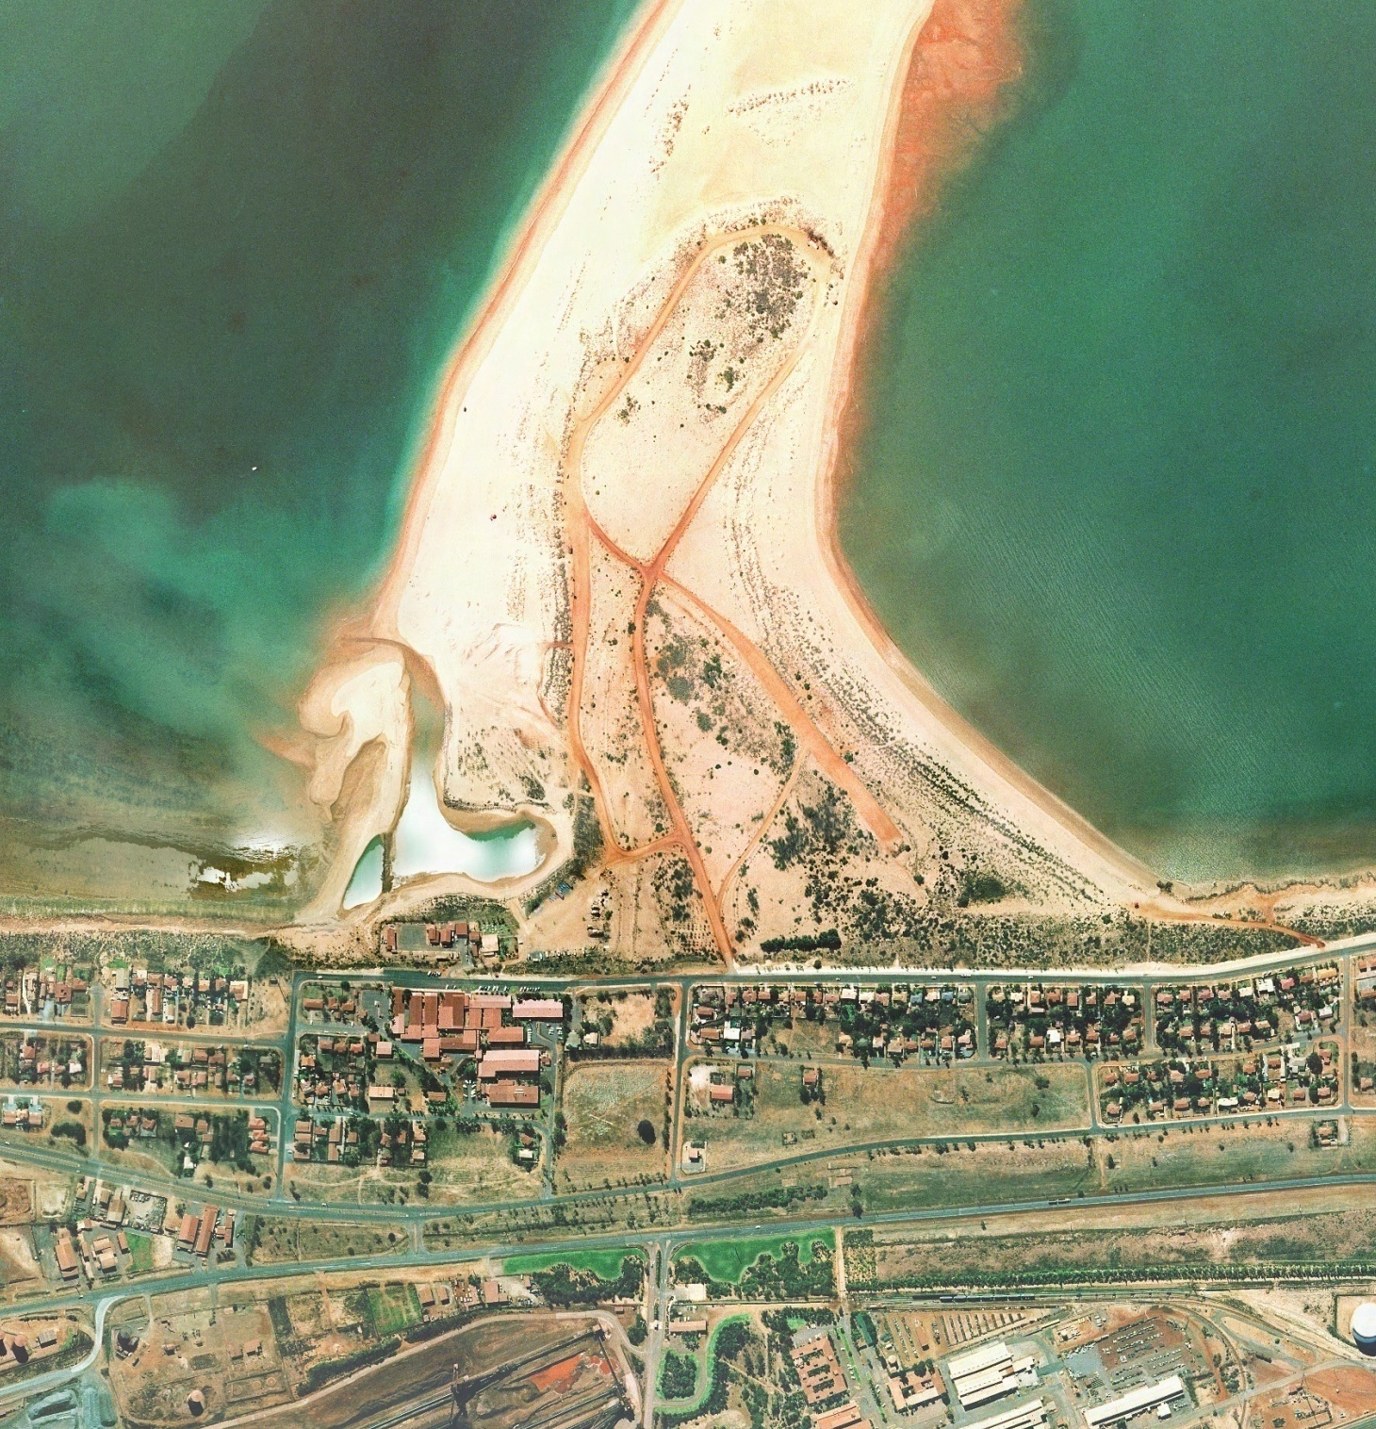
The Spoil Bank today

Slide 5
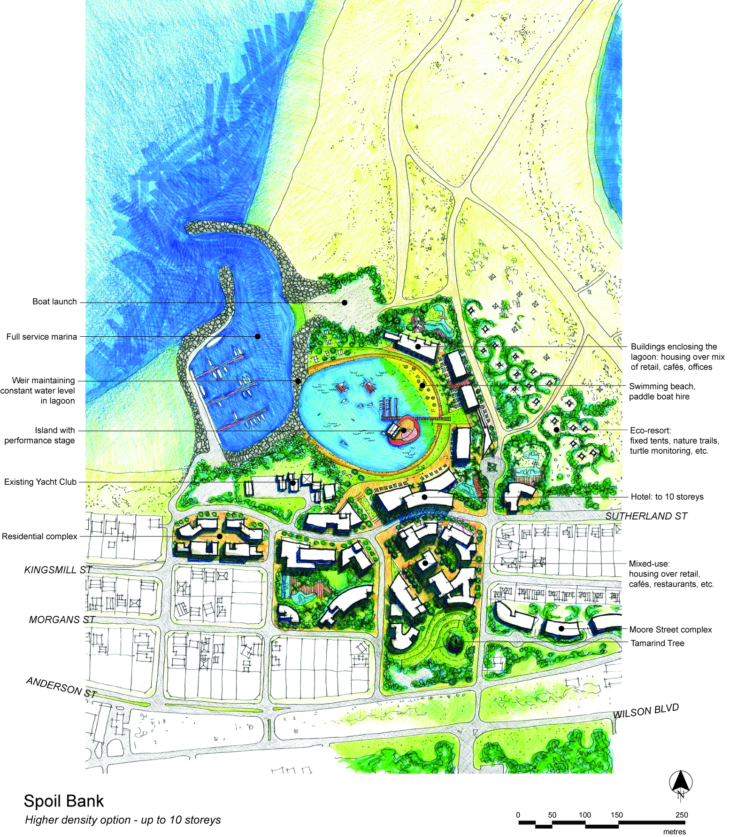
Spoil Bank Option 1
Higher density development
- up to 10 storeys

Slide 6
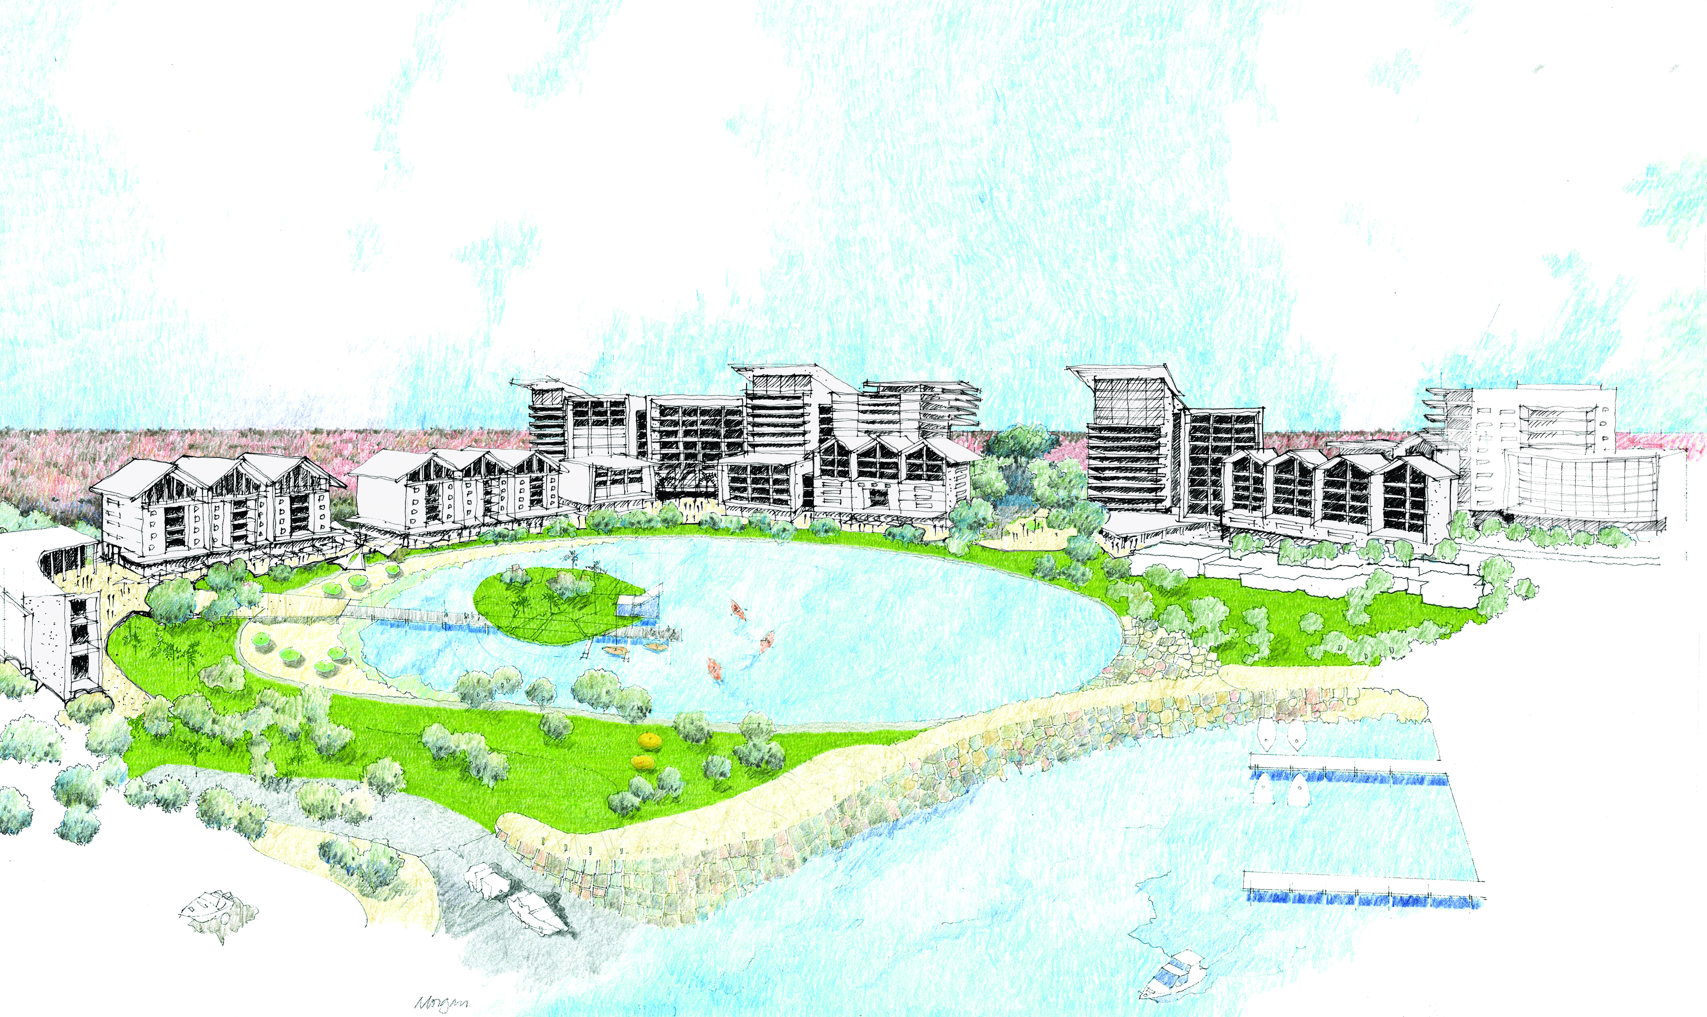
Spoil Bank Option 1
Higher density development - up to 10 storeys

Slide 7
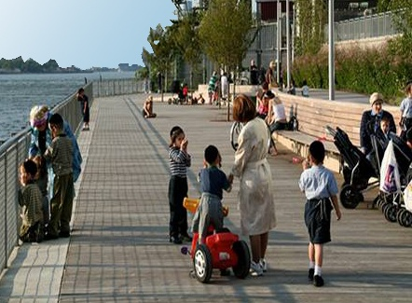
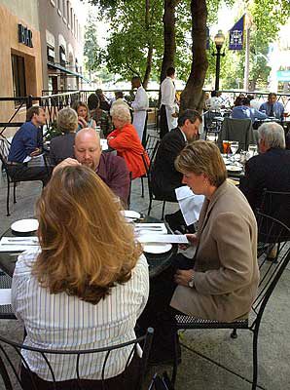
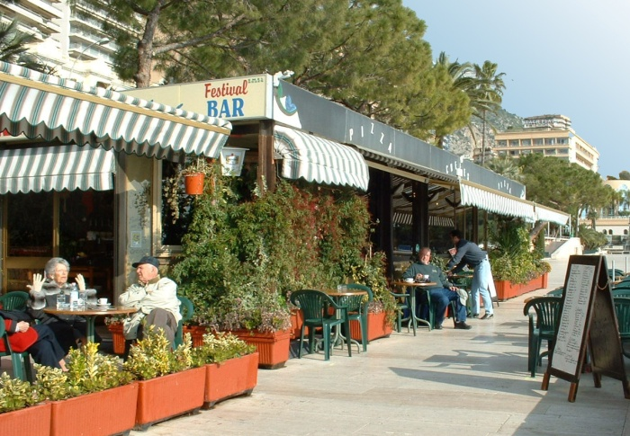
Spoil Bank Option 1
Higher density development
- up to 10 storeys
Artificial lagoon at fixed water level
creates a setting for restaurants and cafés
and terraces down to the water

Slide 8
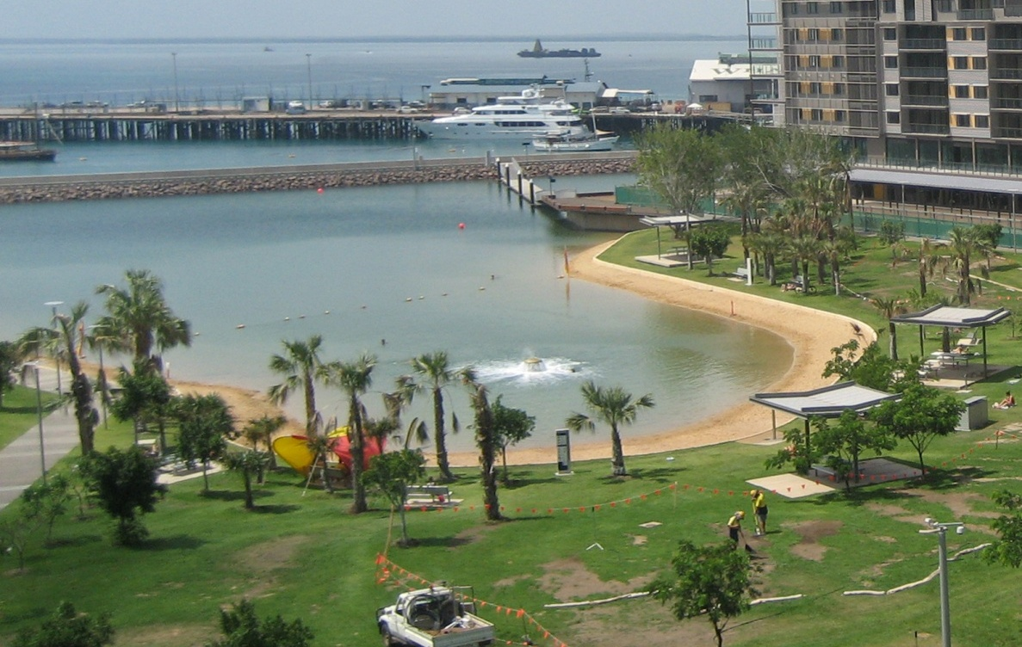
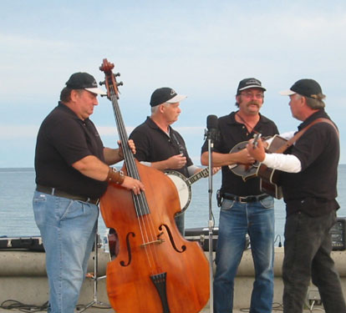
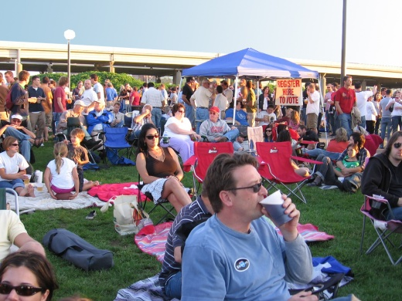
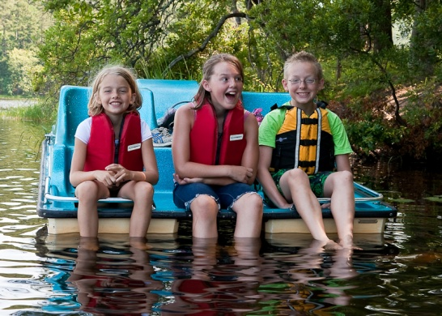
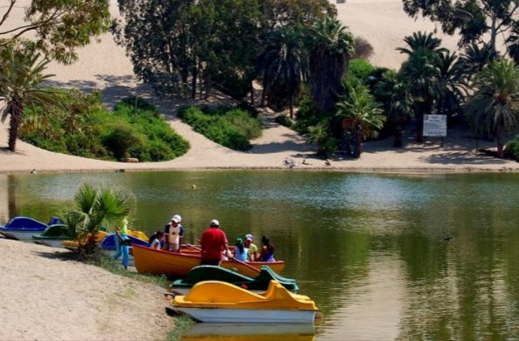
Lagoon offers opportunities for swimming, a place to picnic, hire paddle boats, watch performances on the island stage …

Slide 9
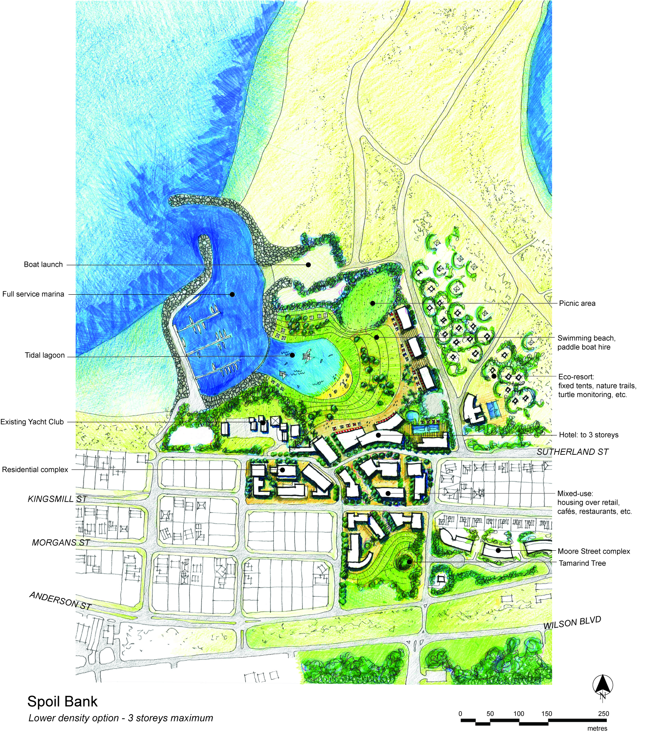
Spoil Bank Option 2
Lower density development
- 3 storeys maximum

Slide 10
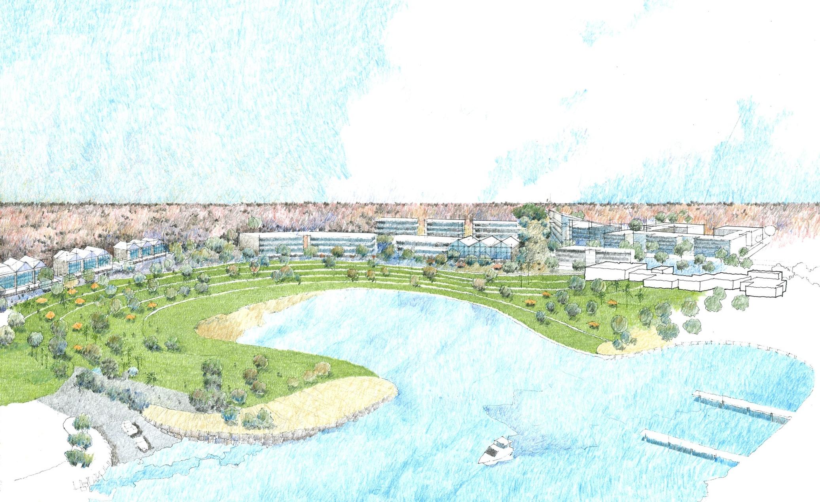
Spoil Bank Option 2
Lower density development - 3 storeys maximum

Slide 11
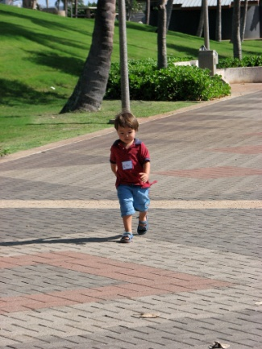
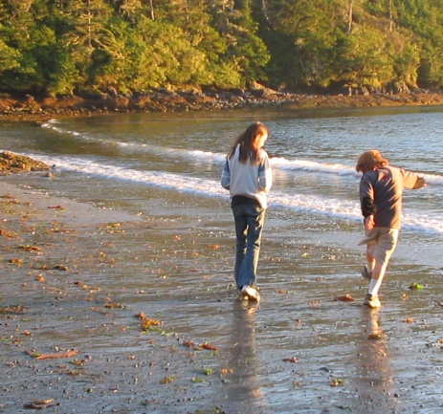
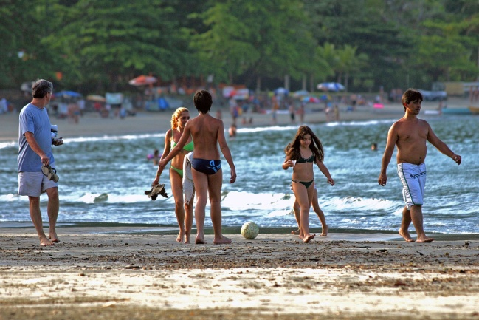
Tidal lagoon has a variable water level, up to 3.2m at high tide.
Water is separated from development by wide, landscaped terraces.

Slide 12
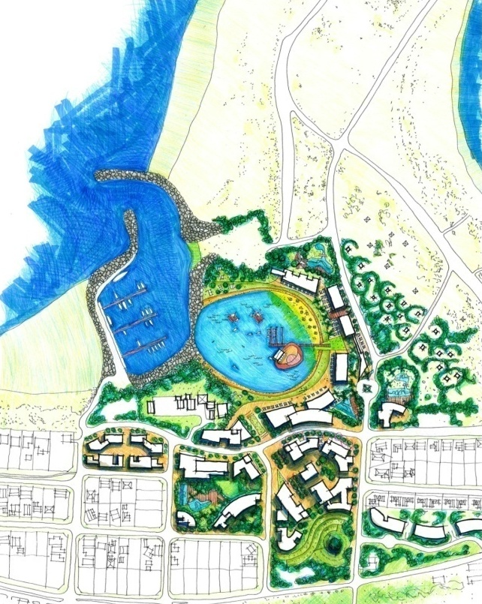
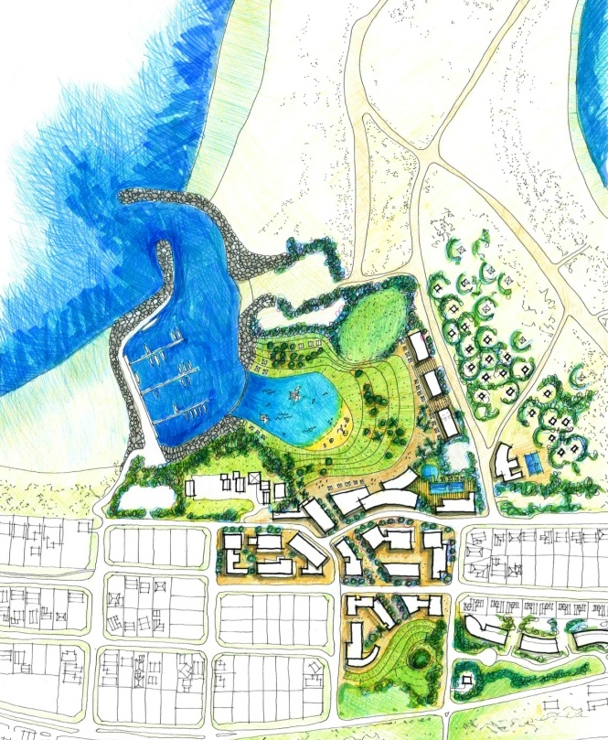
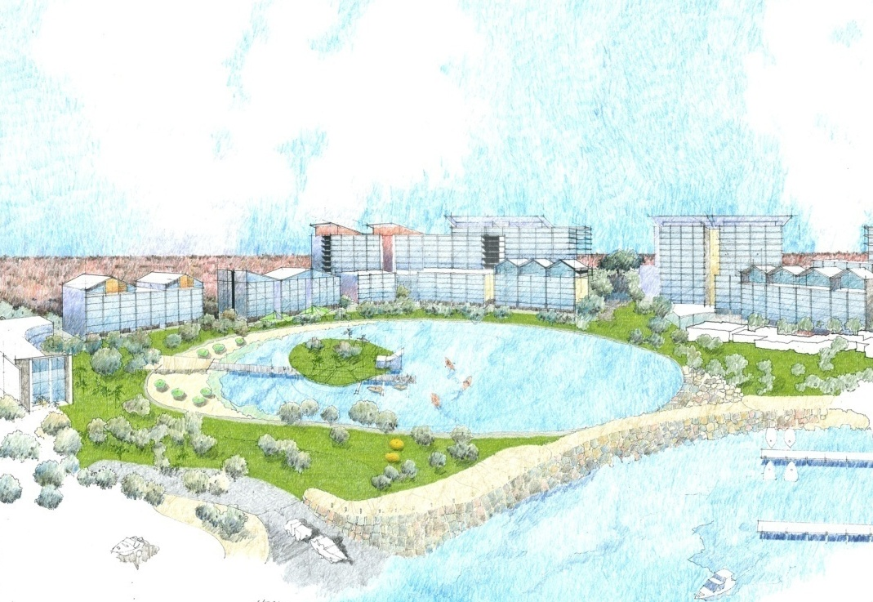
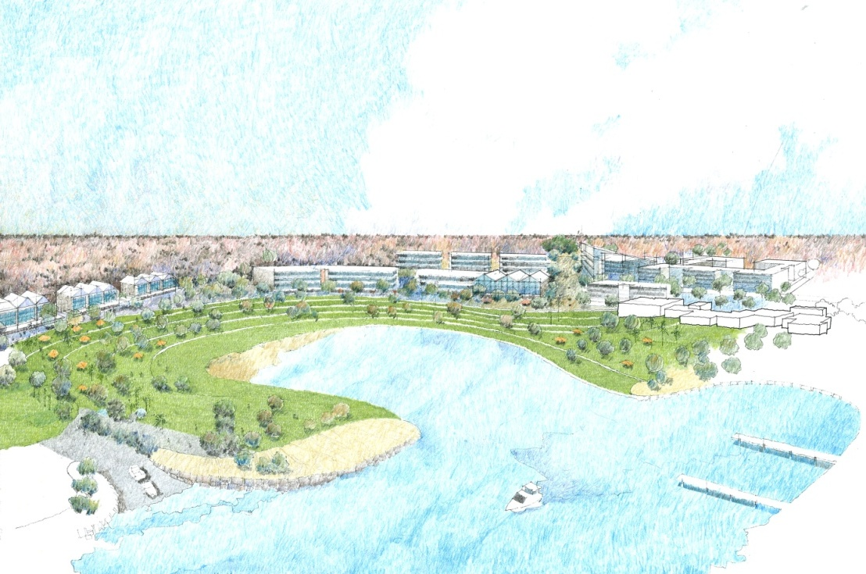
Option 1
Higher density
Fixed water-level
Option 2
Lower density
Tidal lagoon

Slide 13
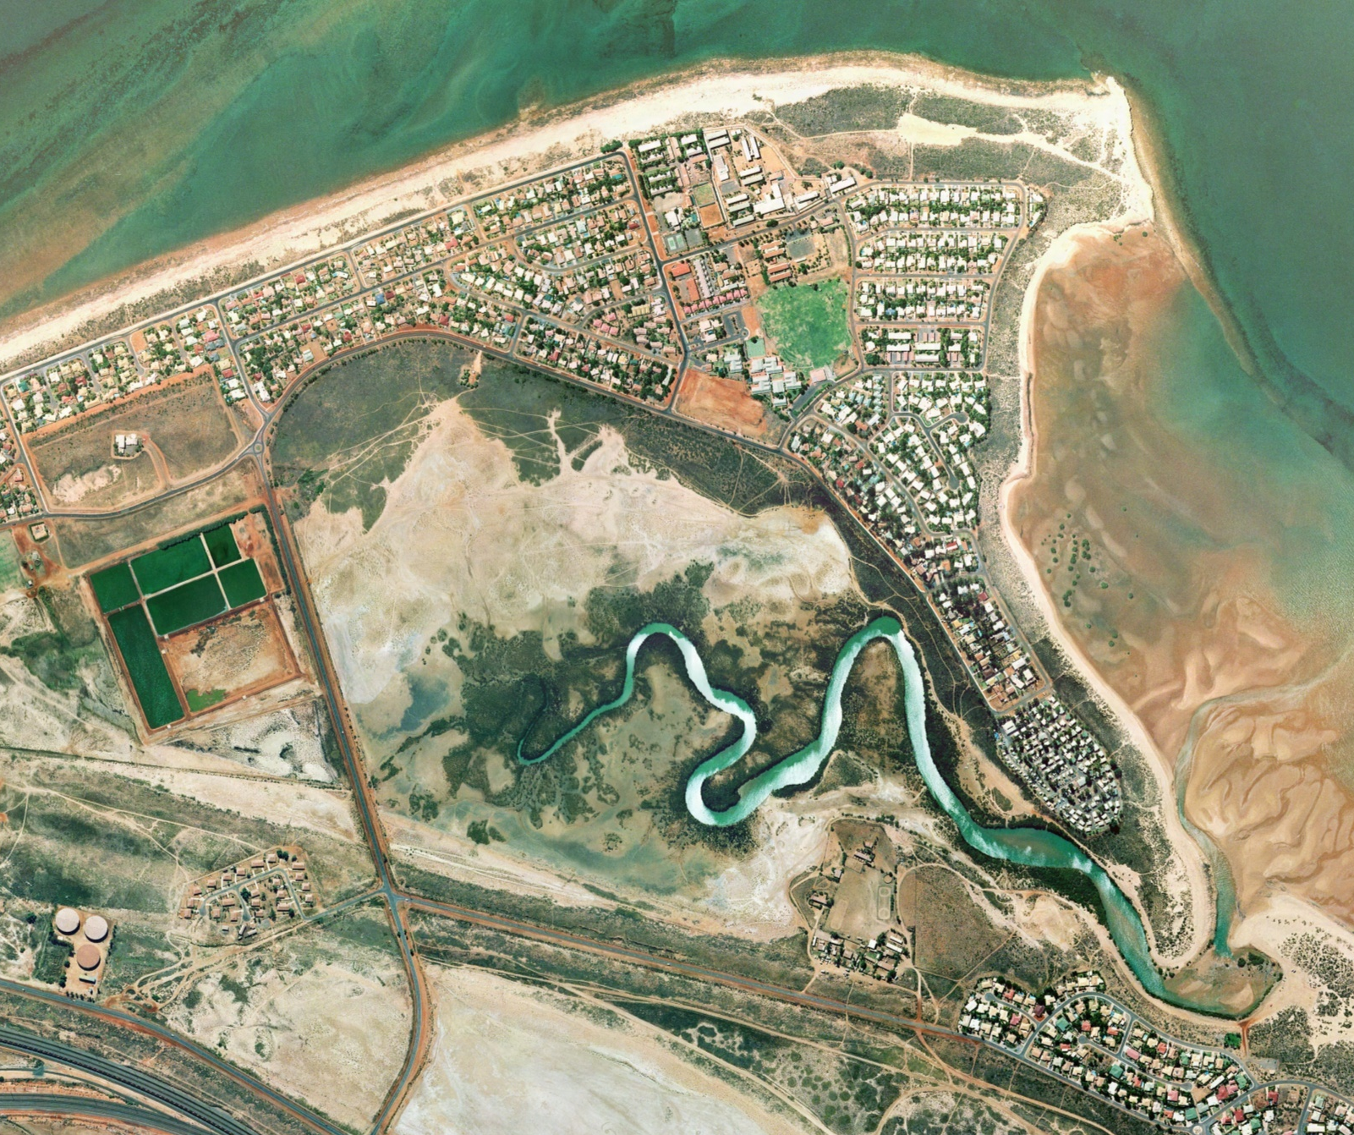
Cooke
Point
Pretty Pool Creek
Wastewater
Treatment
plant
Pretty Pool

Slide 14
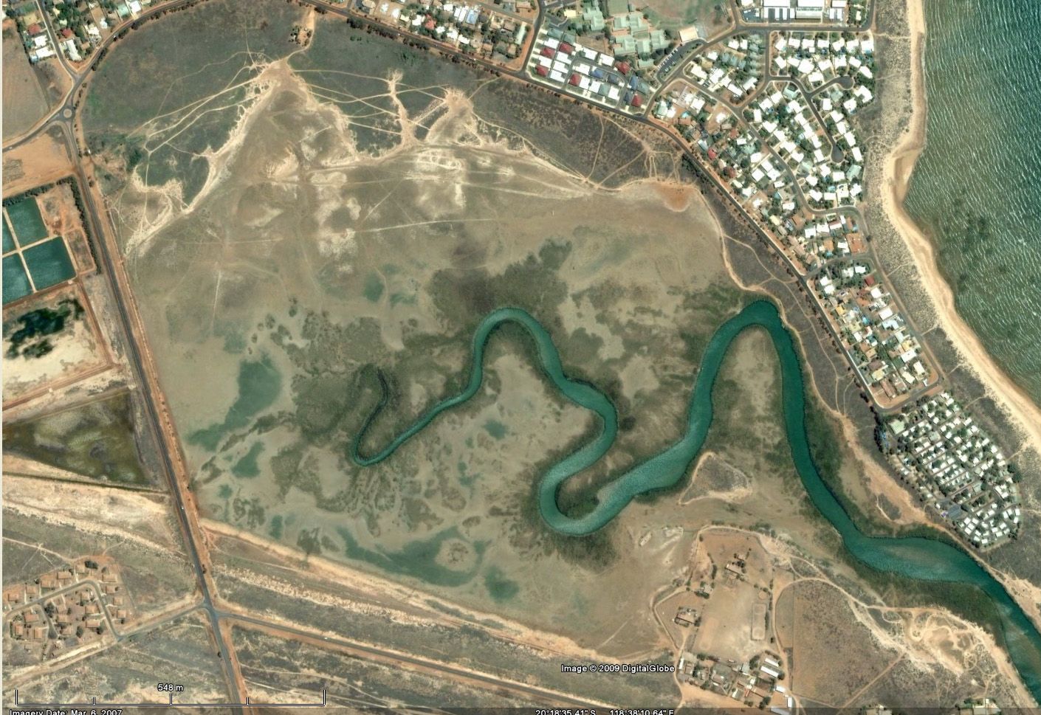
Scale comparison with other waterfront developments:
Cullen Bay, Darwin

Slide 15
Scale comparison with other waterfront developments:
Port Bouvard, Mandurah

Slide 16
Options for the Pretty Pool Creek area are determined by
how water levels are controlled:
Option 1: Natural (no controls)
Option 2: Weir
Option 3: Loch

Slide 17
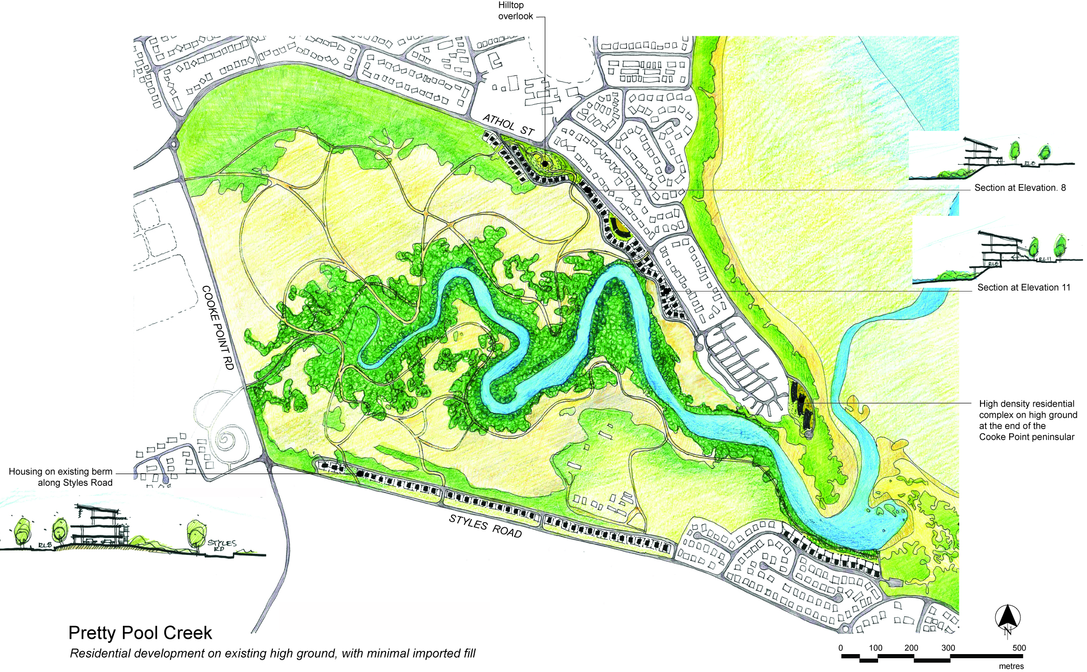
Pretty Pool Option 1
Natural
No water level control.
Development takes advantage of existing higher ground on Athol Street and Styles Road

Slide 18
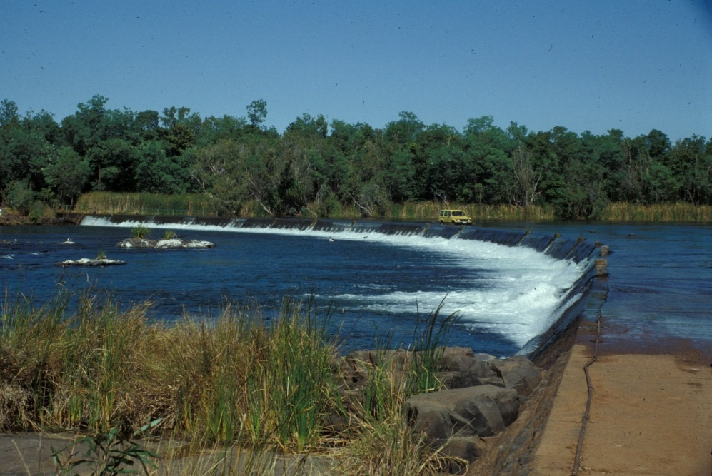
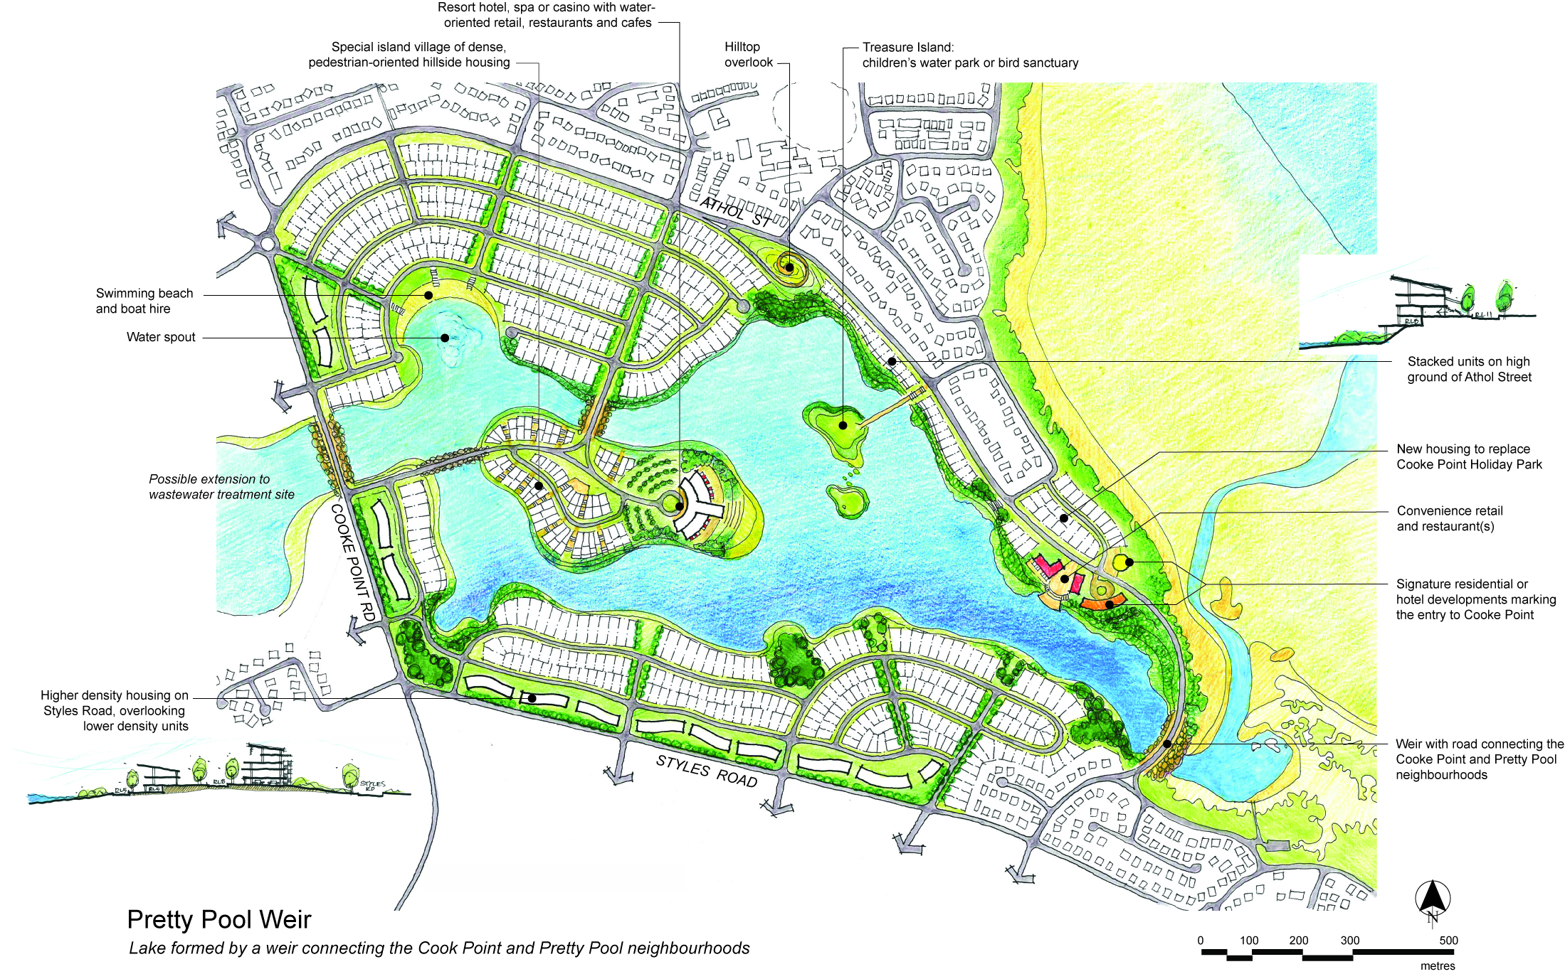
Pretty Pool Option 2
Weir
Water level is controlled by a weir with a road
connection from Cooke Point to Pretty Pool

Slide 19
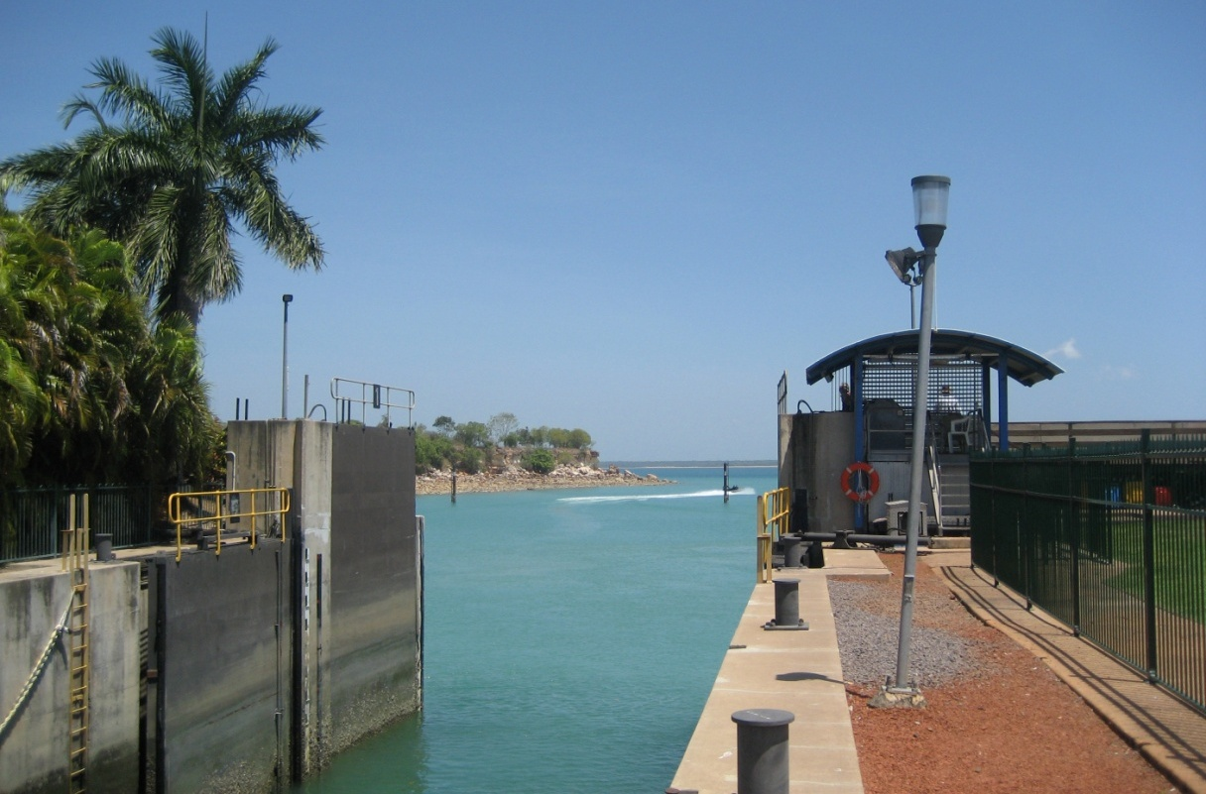
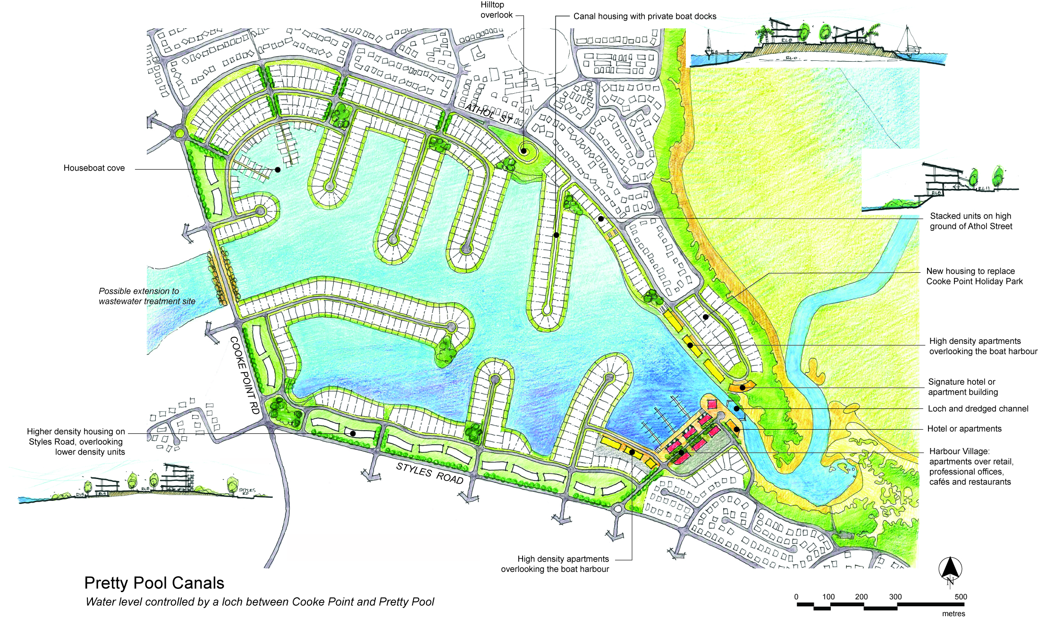
Pretty Pool Option 3
Loch
Water level is controlled by a loch which allows boat access to private docks and a public harbour

Slide 20
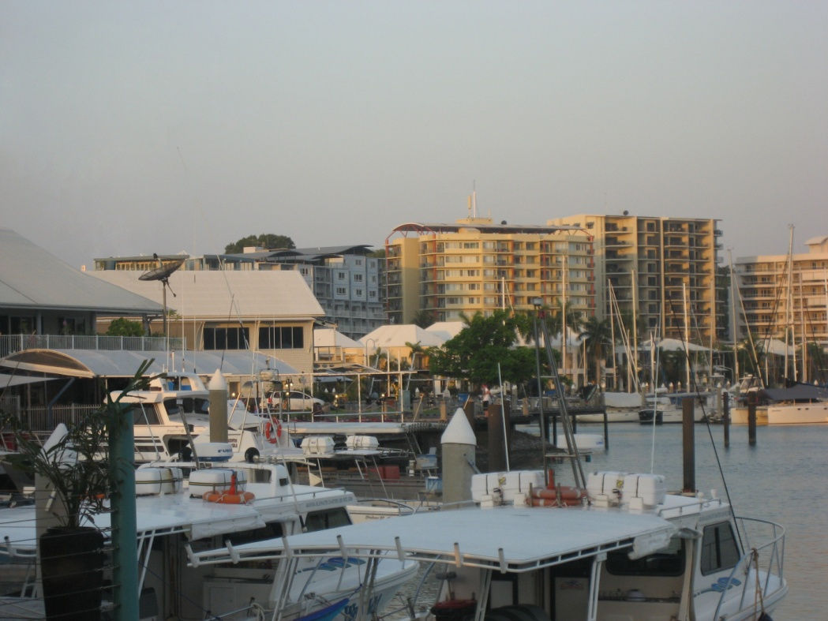
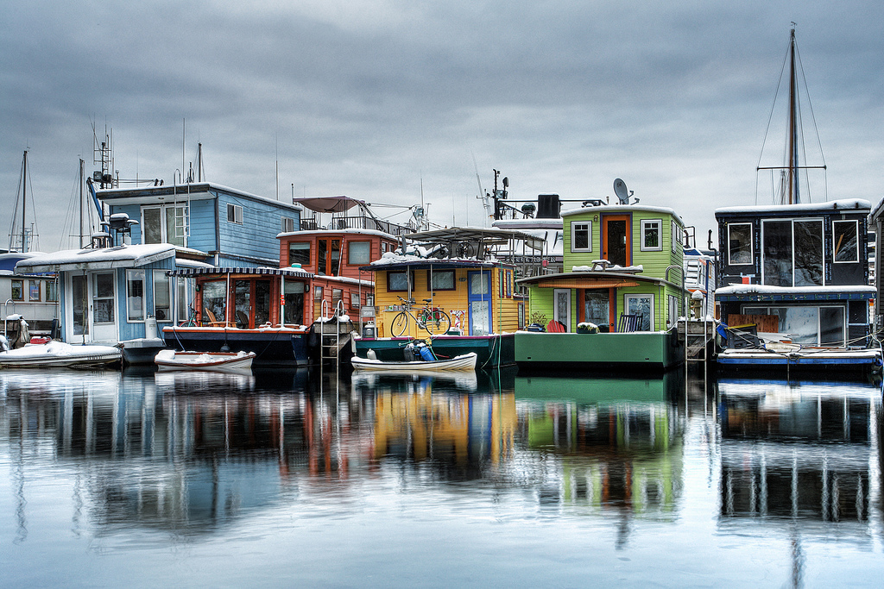
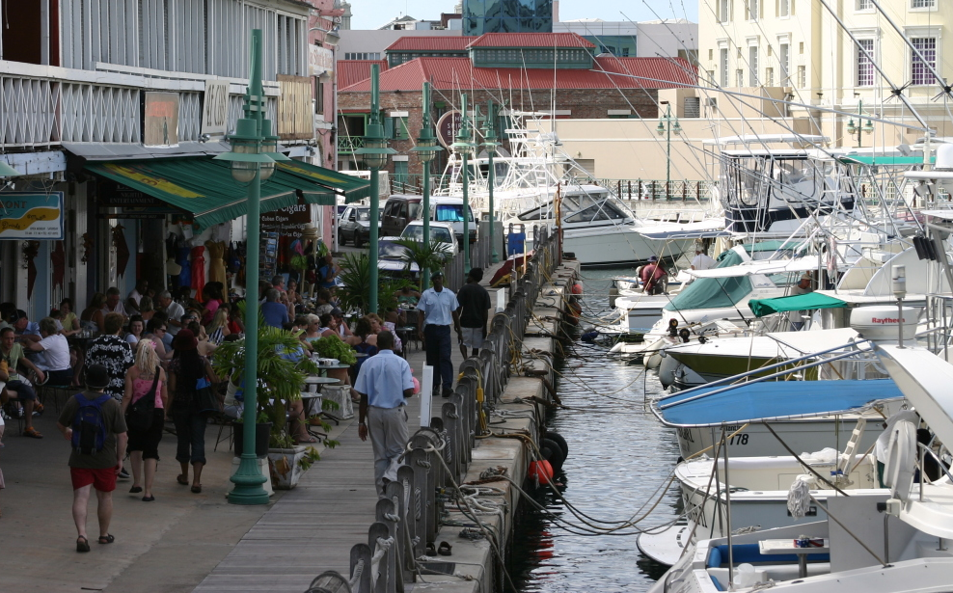
Pretty Pool Option 3
Loch
Fixed water-level and access to open water through the loch allows boats into the artificial lake, providing opportunities for:
private boat docks
a mixed-use village harbour
a houseboat community

Slide 21
1. Natural
Leave the river alone
2. Weir
Connect Cooke Point and Pretty Pool
3. Loch
Create a boat harbour

